Slide 1
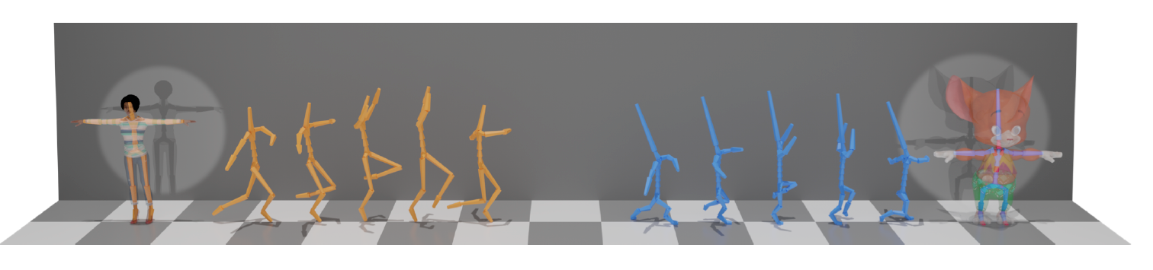
Skeleton Aware Networks for Deep Motion Retargeting (Aberman et al.)
CS 574 Paper Presentation
Nishant Raj

Slide 2
Agenda
Introduction
Related Work
Technical Details: Architectures
Technical Details: Methodology
Experiments and Evaluations
Conclusions

Slide 3
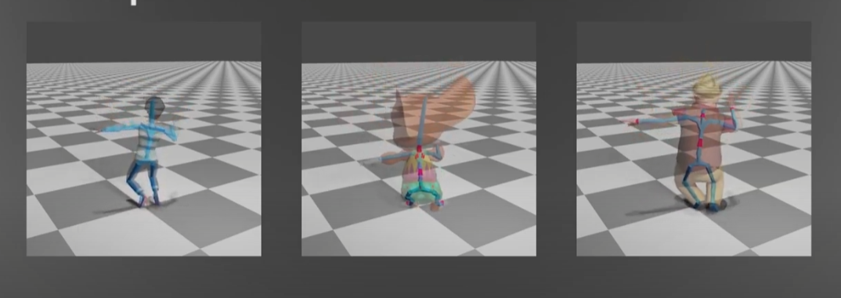
Introduction
Deep Motion Retargeting : Transferring motion from one skeleton structure to another using deep learning without explicitly requiring pairing between motions in training data
Why Deep Motion Retargeting ? : Automation of transferring motion capture and sequences from one animated character to another and training of data-driven model for motion processing tasks
Assumptions in Paper: Motion transfer tasks are performed on homeomorphic skeletons so that they can be reduced to the primal skeleton

Slide 4
Related Works
Classical Approaches in
Motion Targeting
Based on optimization with hand-crafted kinematic motion constraints
(1) Lee & Shin (1999)
(2) Feng et. al. (2012)
Latent Space Representation in
Motion Retargeting
(1) Delhaisse et al. (2017) (2) Jang et al.(2018): Deep Autoencoders
Neural Motion Processing
Aberman et al. : First automatic method of retargeting between different skeleton structure without paired examples using neural motion processing
Skeleton Aware Networks for Deep Motion Retargeting
Neural Motion Processing
(1) Holden et al. : First to apply CNN to 3D Character Animation
Motion is represented as a temporal sequence of 3D-joint processing
Graphs Convolutional Networks (GCNs)
(1) Yan et al. : ST-GCN used spatial convolution for 1 neighbor for each node and temporal conv. on successive position of each joint in time

Slide 5
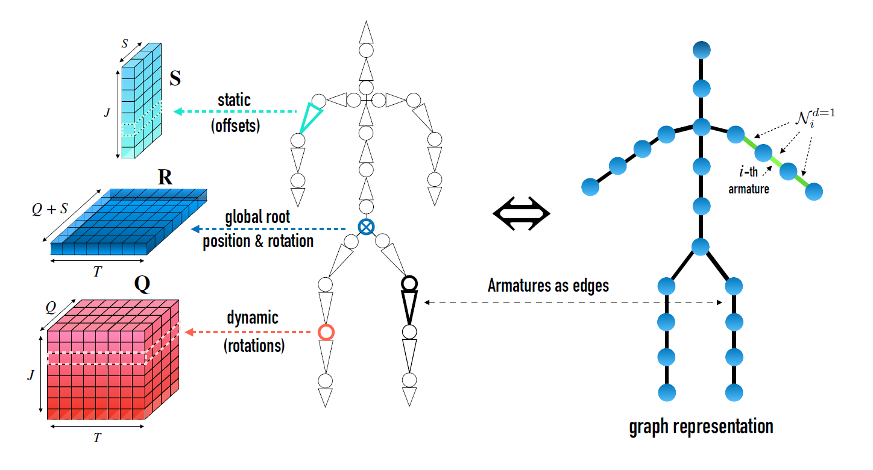
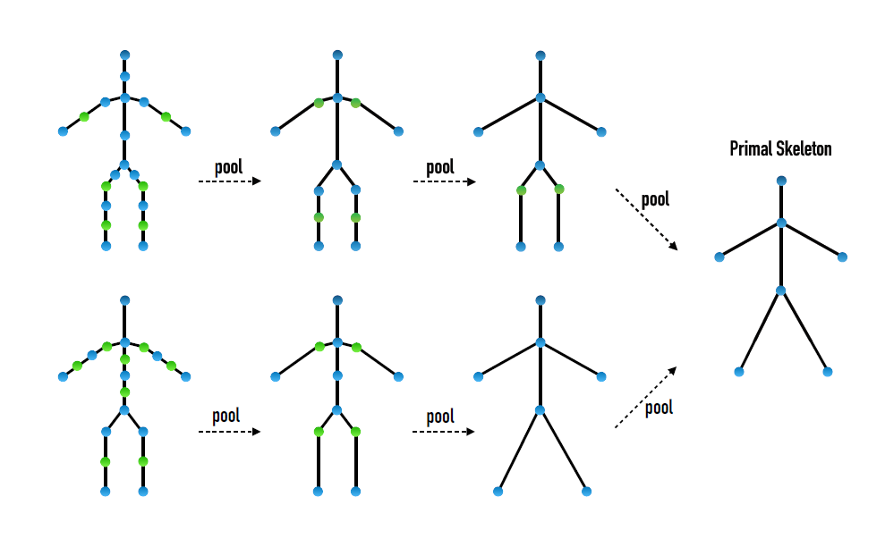
REPRESENTING THE SKELETONS FOR CONVOLUTION OPERATIONS
(DEEP MOTION REPRESENTATIONS)
Motion is represented using a temporal set of armatures that form a graph and represented using a static (offset) and dynamic features (joint rotation)

Slide 6

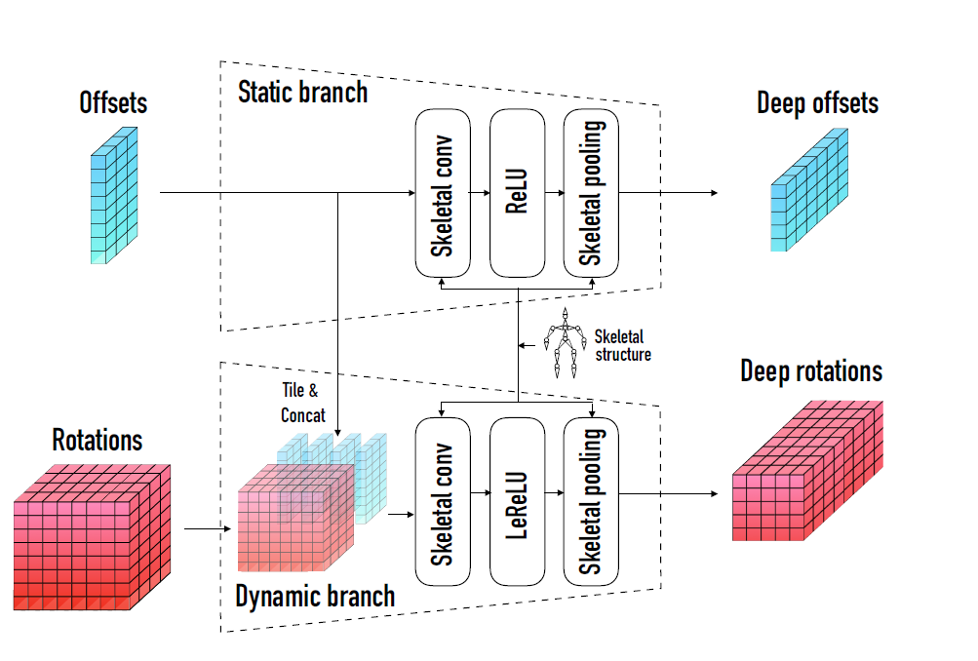
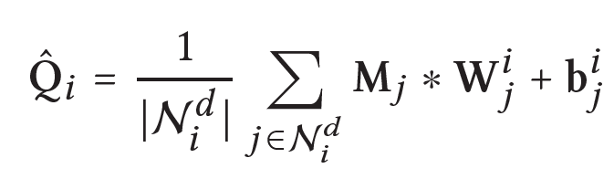
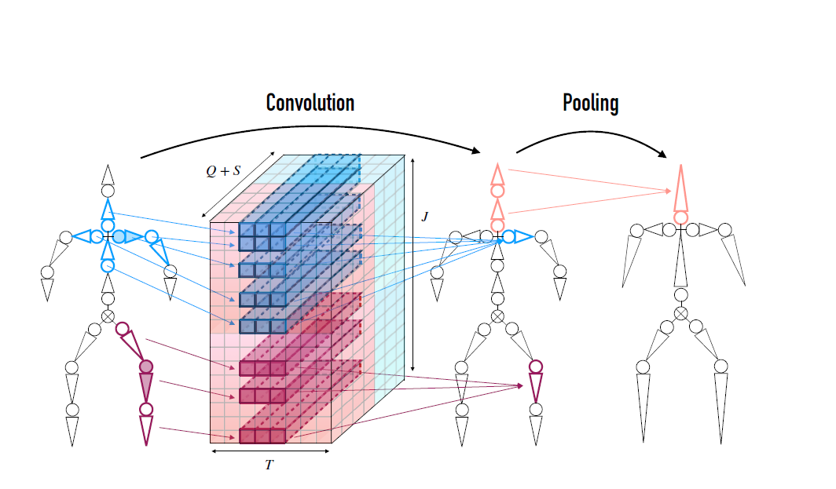
CONVOLUTION FRAMEWORK & OPERATIONS OVER SKELETONS
Skeleto-Temporal Convolution is performed by 1D-CNN (*) operator using above equation on dynamic branch such that #armatures before and after are preserved
Static Representations (Offsets) are tiled and concatenated with dynamic representations along temporal axis in order to capture full motion.
Weights for kernels along temporal axis are shared and along armatures are different

Slide 7
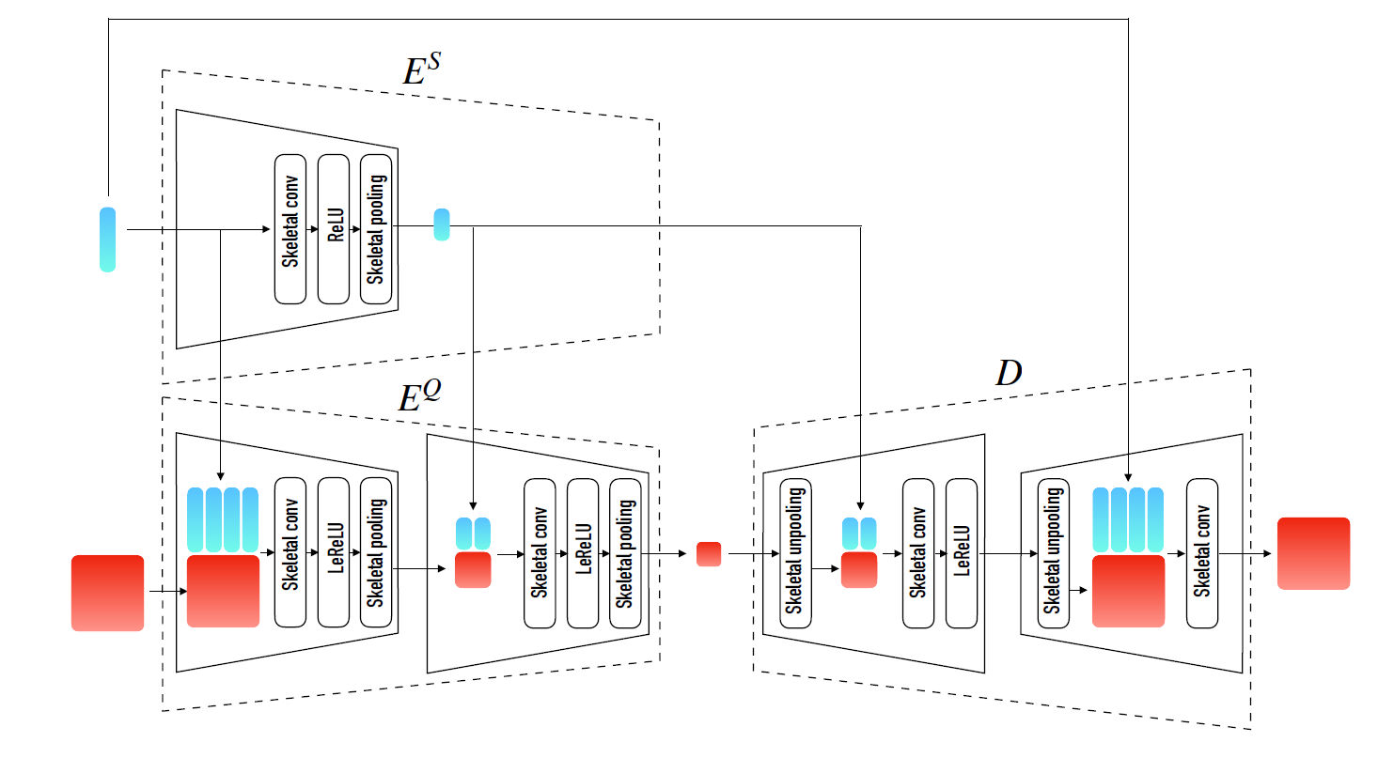
AUTOENCODER ARCHITECTURE WITH PROPOSED CONVOLUTIONAL OPERATORS
Autoencoder has two skeletal blocks in the encoder as well as the decoder. While pooling operation helps to learn deep skeleton with fewer armatures, unpooling operation helps in increasing the resolution of feature operations without increasing the information.

Slide 8
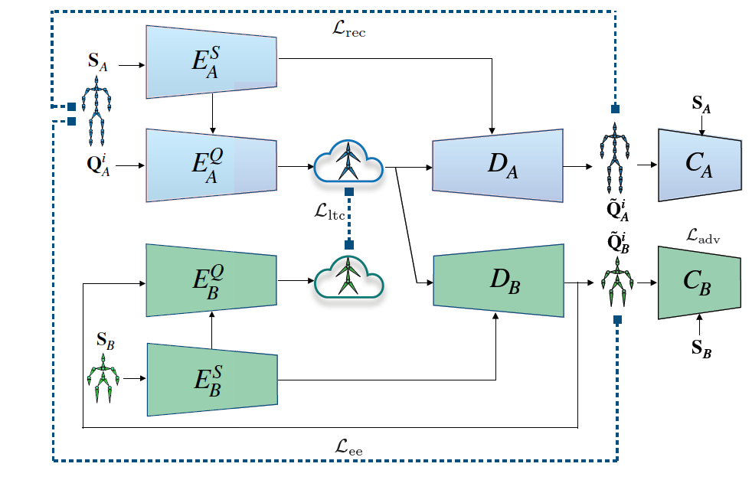
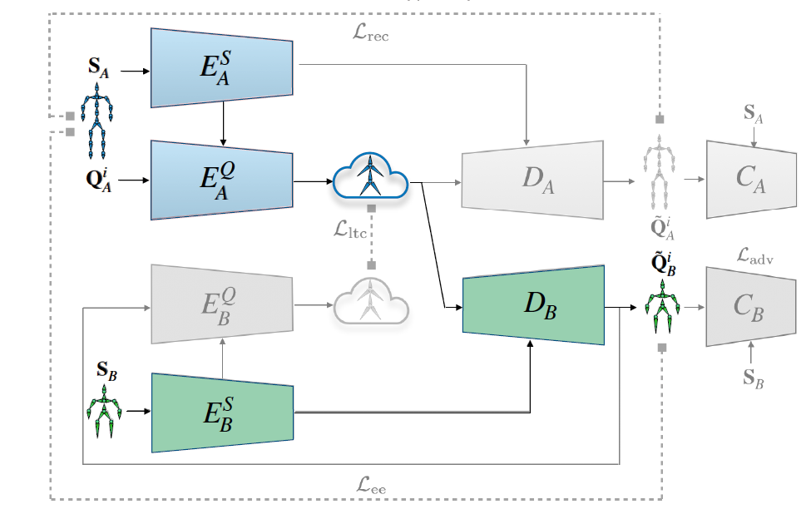
NETWORK ARCHITECTURES DURING TRAINING AND TESTING OF CROSS-STRUCTURAL RETARGETING
TRAINING ARCHITECTURE
TESTING ARCHITECTURE

Slide 9
LOSS FUNCTIONS FOR MOTION-RETARGETING
Motion Retargeting is treated as unpaired cross-domain translation task. (Unpaired: No explicit pair of motion exists across two domains)
4 Loss Function are used for calculating the final loss:
Reconstruction Loss
Used to train Autoencoder architecture in our setting. Applied over joint rotations and positions
Latent Consistency Loss
Ensures that retargeted motion returns same dynamic motion as the original clip
Adversarial Loss
Helps discriminator for unpaired motion to assess if temporal rotations appears to be the plausible motion for the second domain skeleton
End-Effectors Loss
Utilizes property that end-effectors of original and retargeted skeleton have same normalized velocity and helps to achieve perfect motions like foot-sliding

Slide 10
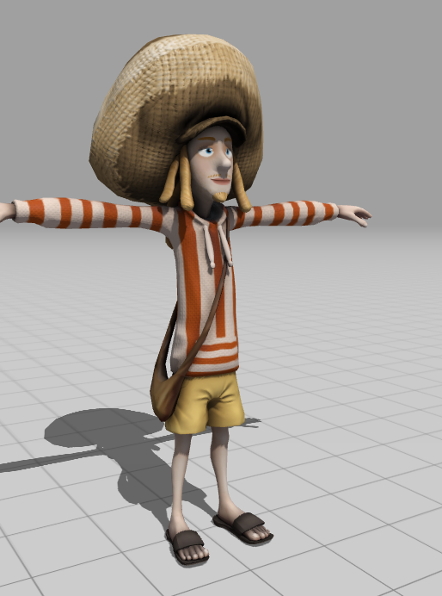


EXPERIMENTS AND EVALUATIONS
Dataset: 29 Characters divided across 2 groups: A(24) and B(5) capturing 2400 motion sequences trained in temporal batches of 64 frames each
Experiments performed on Intra-Structural (same structure and different properties like bone length) and Cross-Structural (different structures of characters having different joints and other differentiations)
No existing methods worked on cross-structural retargeting and hence authors modified CycleGAN and NKN from their original implementation for comparison
For Intra-structural retargeting, comparisons made using NKN (Neural Kinematics Network), PMNet and naïve adaptation of CycleGAN

Slide 11
EXPERIMENTS AND EVALUATIONS
Result Comparisons with different approaches
Method | Intra-Structural Average Error | Cross-Structural Average Error
Villegas et al. (2018) | 6.24 | 243
Lim et al. (2019) | 5.72 | NA
CycleGAN Adaptation (2017) | 7.66 | 8.97
Copy Rotations | 8.86 | NA
Present Paper- conventional operators | 3.95 | 3.56
Present Paper- no shared latent space | 3.01 | 3.06
Present Paper- No Adversarial Loss | 0.47 | 3.81
Present Paper- Full implementation | 2.76 | 2.25
*Present Paper: Skeleton Aware Networks for Deep Motion Retargeting

Slide 12
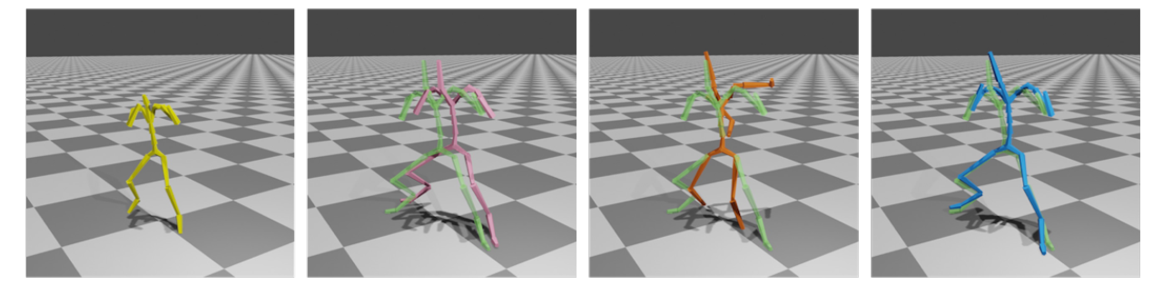
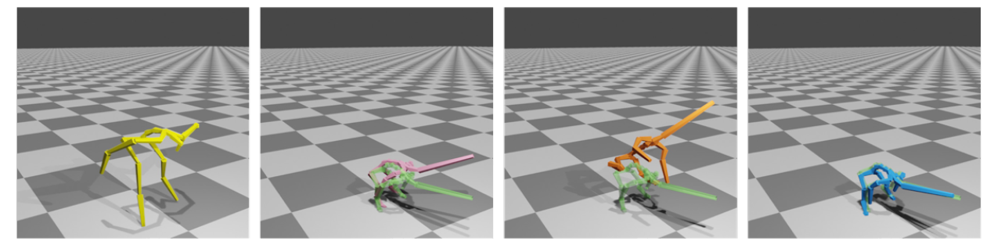
EXPERIMENTAL RESULTS
Visual Result Comparisons with cross-structure motion retargeting
INPUT
CycleGAN
NKN
Present Paper

Slide 13
CONCLUSION AND FUTURE SCOPE
Takeaways
Deep Motion Cross-Structural Targeting can be performed with unpaired sets
Idea of using Latent Space representation is successful because:
Primal Skeletons are close to original structures
Carry deep geometrical feature representation over time
Limitations
Can’t retarget motion properly if characters have different T-poses and move very differently even in homeomorphic skeletons
Future Scope
Extension of work to non-homeomorphic skeletons and need to define a generalized primal skeleton

Slide 14

Thank You
NISHANT RAJ
nishantraj@umass.edu
nishant3815.github.io

